Slide 1
Chapter 2
Research in Psychology:

Slide 2
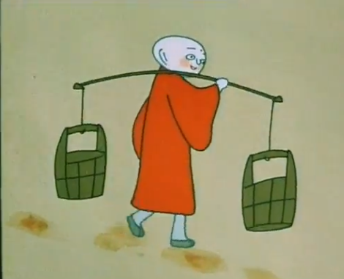
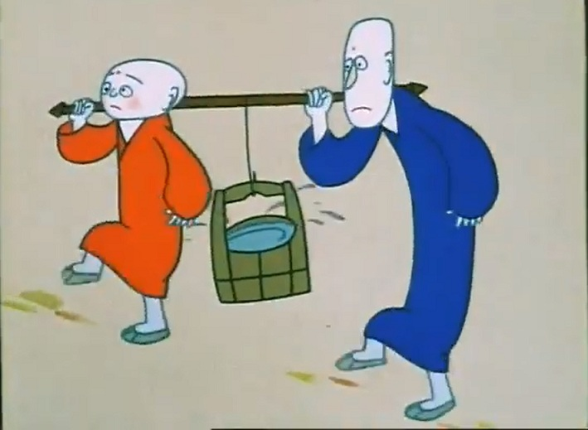
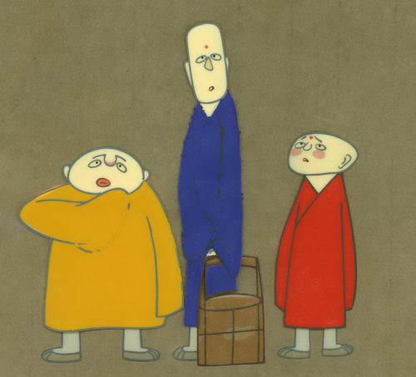
Social Loafing

Slide 3

Critical Thinking

Slide 4
Critical Thinking
Good researchers don’t take common sense explanations for granted.
The process of assessing claims and making judgments on the basis of well-supported evidence.
Question 1
What am I being asked to believe and accept?
Question 2
What evidence is available to support the assertion?
Question 3
Are there alternative ways of interpreting?
Question 4
Question 5
What additional evidence would help evaluate the alternatives?
What conclusion are most reasonable?

Slide 5
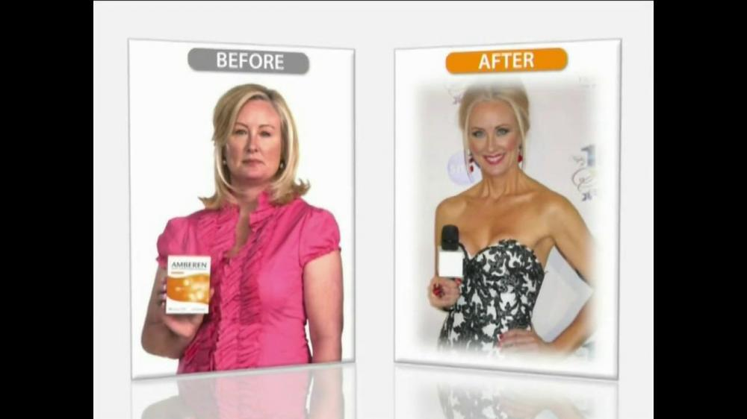

Slide 6
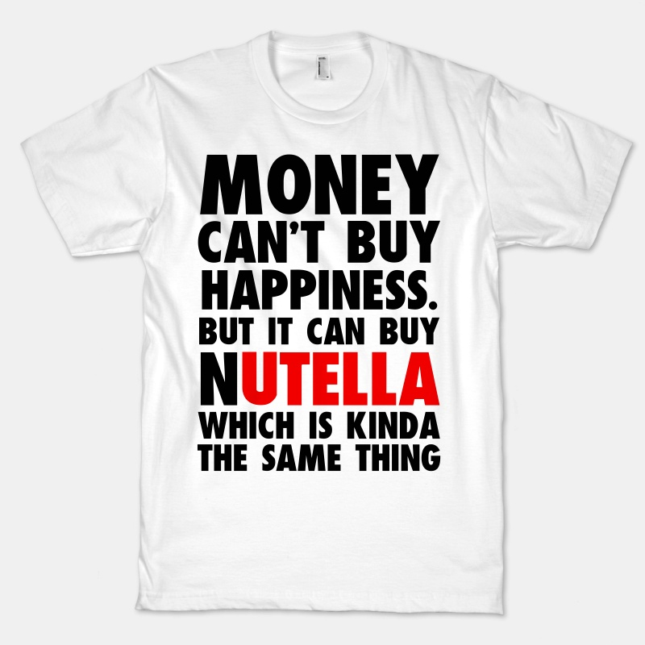
Critical thinking and scientific research
Giving away money
Happiness

Slide 7
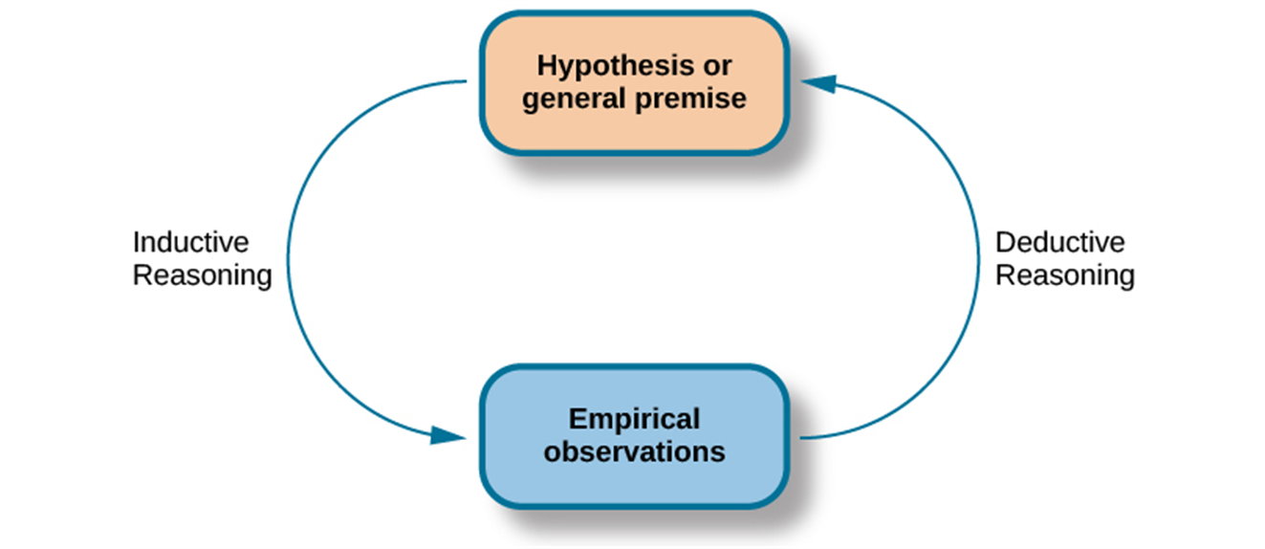
The Process of Scientific Research
Deductive Reasoning
Inductive Reasoning

Slide 8
Key Elements in Scientific Research
Hypothesis: A specific, testable proposition about a phenomenon
Null hypothesis (H0): Treatment has no effect
-Using smartphone in class has no effect on your grade.
-Spending money on others does not produce happiness.
Research hypothesis (H1): Treatment has effect
-Using smartphone in class negatively affects your grade.
-Spending money on others produces happiness.

Slide 9
Key Elements in Scientific Research
Construct: A phenomenon of interest
Operational definition: How you study or examine your phenomenon of interest
Variable: A factor or characteristics that is manipulated or measured in research
Data: Numbers gathered

Slide 10
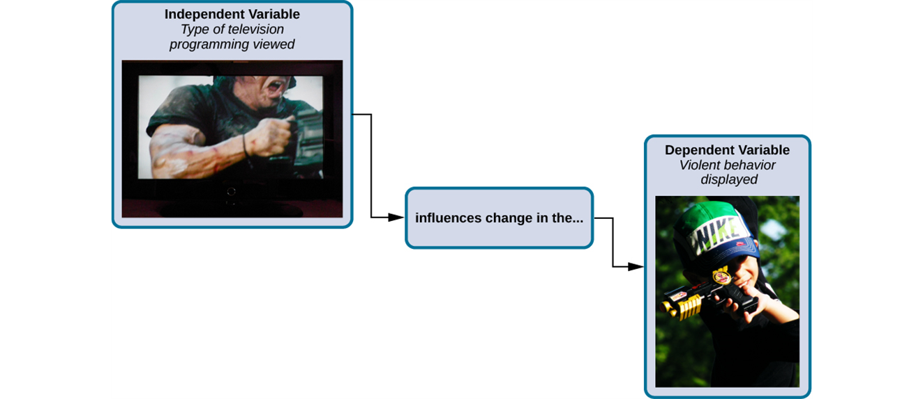
Independent and Dependent Variables
IV (x): what is manipulated or controlled by the experimenter
DV (y): the outcome variable - what the researcher measures to see how much effect the IV had

Slide 11
IV? DV?
Does acupuncture reduce lower back pain?
Is work stress related to insomnia?
Is Medicine XX effective in reducing the likelihood of getting breast cancer?

Slide 12
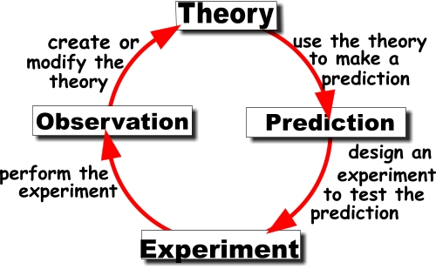
The Role of Theories
Theory: A set of statements designed to account for, predict, and even suggest ways of controlling certain phenomena.

Slide 13
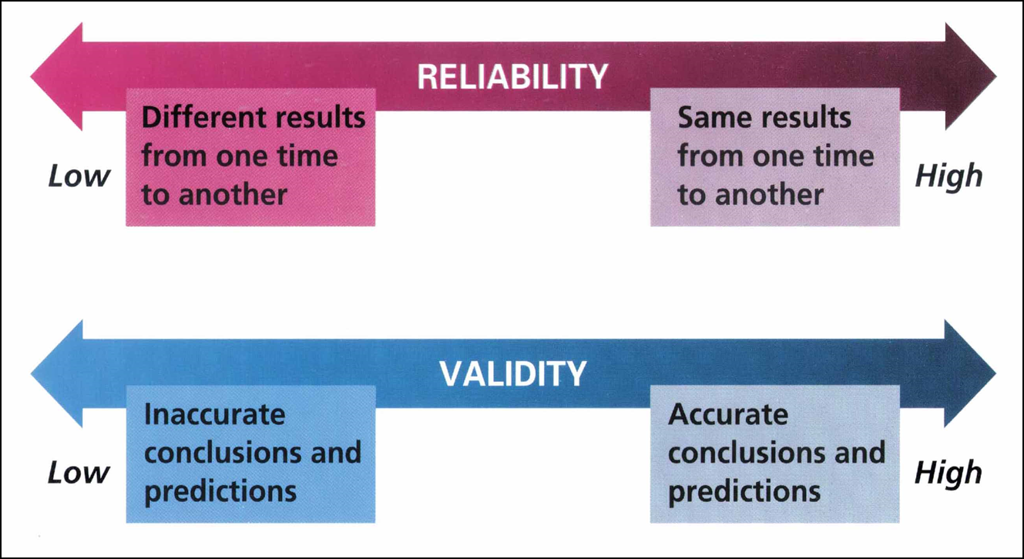
Reliability and Validity
Reliability: the degree to which a measure is free from random errors
Validity: the degree to which a measure really measures what it is supposed to measure

Slide 14
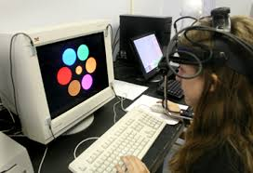
Research Methods in Psychology

Slide 15

Method #1: Observational Methods
Naturalistic observation: the process of watching without interfering as behavior occurs in natural environment.
Pros: Large amount of useful data
Cons: People tend to act differently when being watched
Notes:
Change another example

Slide 16
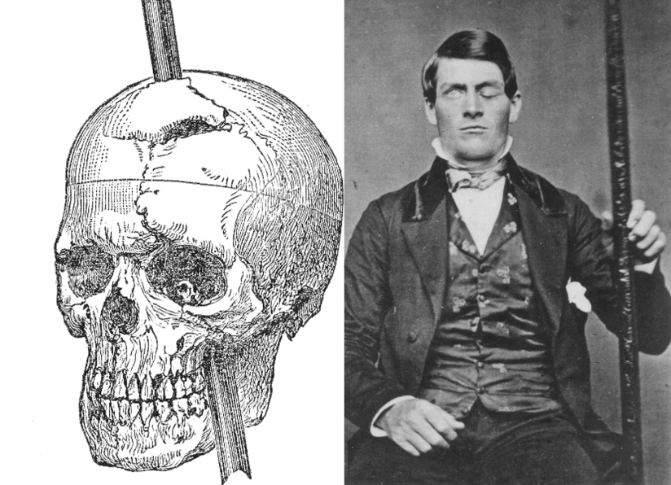
Method #2: Case Studies
A research method involving the intensive examination of some phenomenon in a particular individual, group, or situation.
Pros: Raw and pioneer materials for future research
Cons: Rare cases are not representative

Slide 17
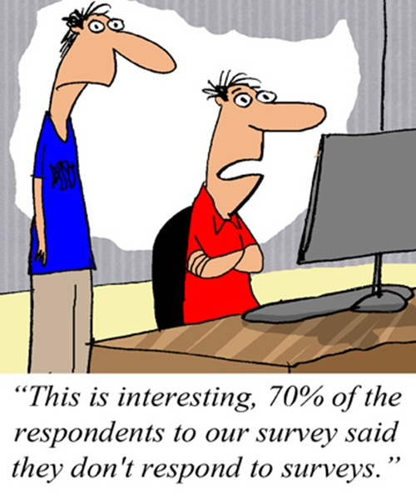
Method #3: Surveys
Giving people questionnaires or interviews to understand their attitudes, beliefs, opinions, and intentions.
Pros: wide-angle views of large groups, efficient
Cons: sampling errors, responses biases, poorly written questions

Slide 18
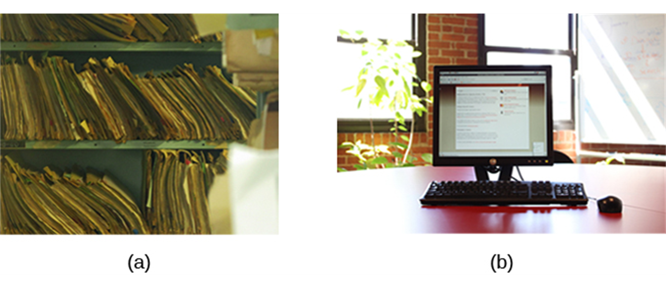
Method #4: Archival Research
Use existing record (e.g., data) to answer research questions.
Pros: less time and money investment
Cons: no control over what information was originally collected.

Slide 19
Method #5: Longitudinal and Cross-Sectional Research
Longitudinal research: Data-gathering is administered repeatedly over an extended period of time.
Pros: Reduce bias, more informative results
Cons: Incredible time investment, attrition
Cross-sectional: Data-gathering is administered once.

Slide 20
Correlational Studies
Examines relationships between variables in order to analyze trends in data, test predictions, evaluate theories, and suggest new hypotheses.
Happiness
Charity Donation

Slide 21
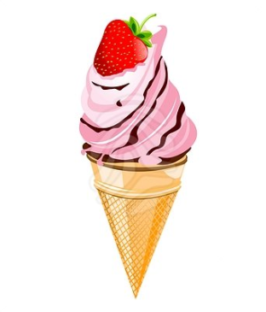
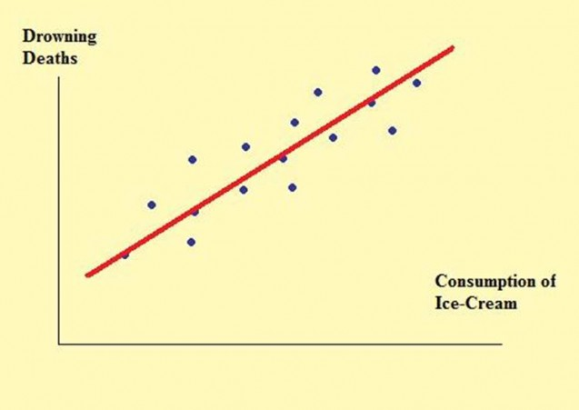


Correlational Studies (cont’d)
Correlation ≠ Causation
Correlation

Slide 22
Experiments
A research method in which the experimenter manipulates one variables and then observes the effect of that manipulation on another variable, while holding all other variables constant.
Experimental group vs. Control group
Independent variable & Dependent variable
Experimental Group
Receive Treatment
Reports on the DV
Prosocial Spending
Happiness
Control Group
No Treatment
Reports on the DV
Personal Spending
Happiness
Manipulation of the IV
Notes:
While holding all others constant*
Define IV, DV using example
How the experiment occurs

Slide 23
Experiments (cont’d)
Random variables
Uncontrolled, uncontrollable
random assignment of research participants
The placebo effect: Improvement occurs as a result of a participant’s knowledge and expectations (but not as a result of the treatment)
Experimental bias: can be prevented by double-blind design

Slide 24
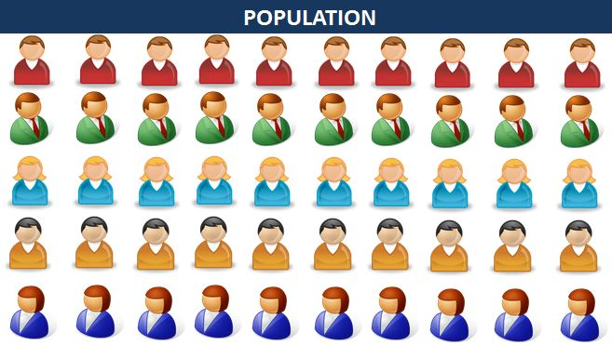
Selecting Human Participants for Research
Why should researchers be careful about sampling?
Sampling affects results.
NOT representative
Random sampling:
Number each individual (1-50)
Put all the numbers into a hat
Draw 15 numbers from the hat randomly
Representative

Slide 25
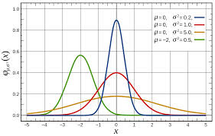
Statistical Analysis of Research Results

Slide 26
Descriptive Statistics: Central Tendency
Mode
Median
Mean
Name | Weight (lbs)
Jack | 49
Ben | 49
Amy | 51
Jill | 52
Susan | 54
Jason | 55
Peter | 56
Blake | 60
Jerry | 60
Chris | 60
Jenny | 63

Slide 27
Descriptive Statistics: Variability
Range
Standard Deviation
Name | Weight (lbs)
Jack | 49
Ben | 49
Amy | 51
Jill | 52
Susan | 54
Jason | 55
Peter | 56
Blake | 60
Jerry | 60
Chris | 60
Jenny | 63
Name | Weight (lbs)
Jack | 8
Ben | 10
Amy | 22
Jill | 34
Susan | 43
Jason | 55
Peter | 68
Blake | 76
Jerry | 82
Chris | 102
Jenny | 109

Slide 28
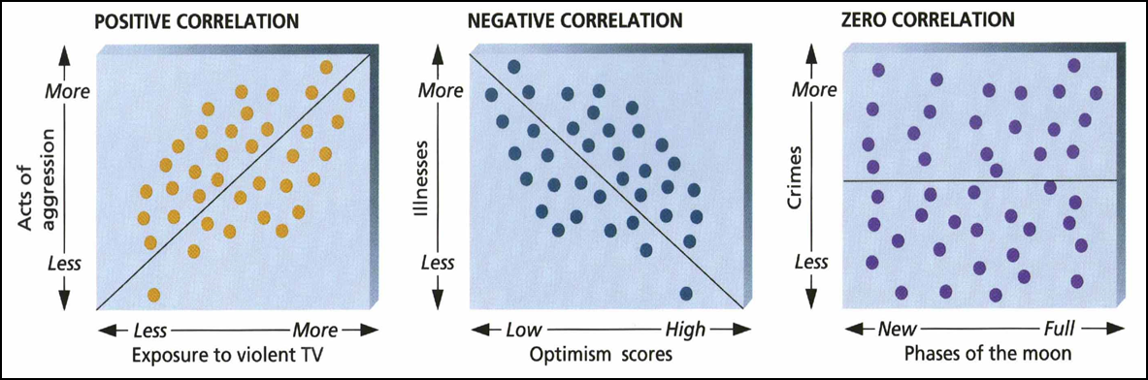
Descriptive Statistics: Correlation
The degree to which one variable is related to another.
Positive correlation: X and Y change in same direction
Negative correlation: X and Y change in opposite direction

Slide 29

Ethical Guidelines for Psychologists

Slide 30
Ethics in Psychological Research
Caring for animals and human subjects in research: preserving their welfare and dignity
Institutional Review Board (IRB): http://www.uah.edu/IRB/
Ethical Principles of Psychologists and Code of Conduct (APA, 2002)

